Slide 1


Demographic Insights and Behavioral Patterns: A Comprehensive Analysis
Insights into Income, Lifestyle, and Behavioral Trends

Slide 2
Presented By: Israt Jahan Roll: 03

Slide 3
Contents
Abstract
Introduction
Data Set Analysis
Challenges
Methodology
Results
Conclusion

Slide 4
Abstract
This report presents an in-depth analysis of a dataset comprising demographic, economic, and lifestyle attributes. The primary objective is to uncover trends and relationships between variables such as marital status, income, education, and consumer behavior, particularly bike purchases.
Key points
Comprehensive dataset covering demographics, income, and purchasing behavior.
Key insights: income trends, marital status impact, education correlations, and bike purchasing behavior.
Practical applications for marketing strategies and resource allocation.

Slide 5
Introduction
This report examines a dataset encompassing various demographic, economic, and lifestyle attributes to derive actionable insights. The primary objective of the project is to answer research questions related to income, marital status, education, and consumer behavior, such as bike purchases.

Slide 6






Dataset Overview
Occupation
Home Owner
Cars Owned
ID
Children
Gender

Slide 7

Challenges
The analysis faced several challenges that required strategic problem-solving:
Data Quality Issues: Missing values were prevalent in some columns, requiring imputation or exclusion strategies to ensure the dataset remained usable and accurate.
Complex Interdependencies: Many variables, such as education, income, and marital status, exhibited interdependencies. Careful consideration was needed to untangle these relationships and derive meaningful insights without introducing bias.
Correlation vs. Causation: One significant challenge was distinguishing correlation from causation. While trends and patterns were identified, it was crucial not to infer causative relationships without sufficient evidence.
Data Volume: The size of the dataset posed computational challenges. Efficient tools and methodologies were employed to handle large-scale data processing and visualization effectively.
Interpretation of Results: The insights required careful interpretation to ensure they were actionable and relevant to real-world scenarios. Balancing statistical significance with practical application was a constant focus.
Diverse Variables: The dataset contained a variety of categorical and numerical variables, each requiring tailored approaches for analysis. Proper encoding and normalization were necessary to facilitate meaningful comparisons.

Slide 8
Methodology
Flowchart
Data Cleaning (Missing value handling, duplication removal).
Exploratory Data Analysis (EDA) (Trends, correlations).
Feature Engineering (New metrics, encoding variables).
Segmentation (Age, marital status, income levels).
Hypothesis Testing (Statistical validation).
Methodology
Data Cleaning
Feature Engineering
EDA
Segmentation
Hypothesis Testing

Slide 9
Results
A graph depicting gender distribution across four categories—age, marital status, children, occupation, and region—provides insightful comparisons. It highlights differences in male and female representation within each category, showcasing trends such as age-specific gender ratios, variations in marital status, parental roles, occupational disparities, and regional gender distribution. . For example, younger age groups may exhibit a more balanced gender distribution, while certain occupations could show a higher prevalence of one gender. Similarly, the presence of children might influence gender representation differently across marital statuses. Regional trends could reflect cultural or socioeconomic factors shaping these distributions. This comprehensive analysis offers a nuanced view of gender dynamics in diverse aspects of life.
Gender Distribution by Category
Figure
1
:
Gender Distribution by Category
120
100
80
60
Female
Male
40
20
0
Marital Status
Children
Age
Region

Slide 10
Results
Individuals with Marital Status
A detailed analysis of marital status across five categories—children, homeownership, car ownership, bike purchases, and occupation—reveals significant patterns that offer a glimpse into the interplay between personal and economic factors. Married individuals are more likely to have children compared to single or divorced individuals, reflecting traditional family structures. Homeownership also tends to be higher among married couples, as dual incomes often provide greater financial stability, enabling investments in property. In contrast, single individuals may show a preference for renting due to flexibility and fewer family-related obligations. Car ownership is another area of interest, with married individuals often owning multiple vehicles to accommodate family needs, while single individuals may rely on a single car or alternative transportation.
Individuals with Marital Status
Figure
2
:
Individuals with Marital Status
Total
Children
Home Owner
Cars
Purchased Bike
Occupation

Slide 11
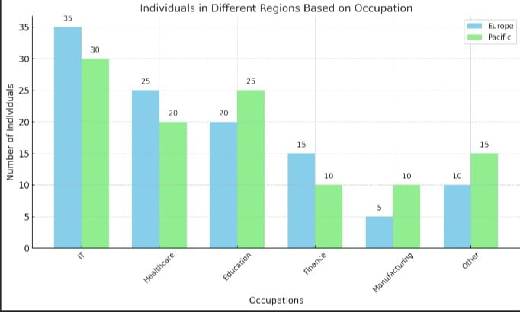
Results
Individual Living in Region Based On Occupation
The occupational distribution of individuals living in different regions, such as Europe and the Pacific, reflects unique economic structures, cultural priorities, and geographic influences. In Europe, a significant portion of the workforce is concentrated in industries such as finance, manufacturing, and technology, particularly in urban hubs like London, Berlin, and Paris. These regions often exhibit a high demand for skilled professionals, including engineers, software developers, and financial analysts. Rural areas in Europe, on the other hand, tend to have a greater prevalence of agriculture, small-scale manufacturing, and tourism-related occupations, driven by the continent's rich historical and natural attractions.

Slide 12
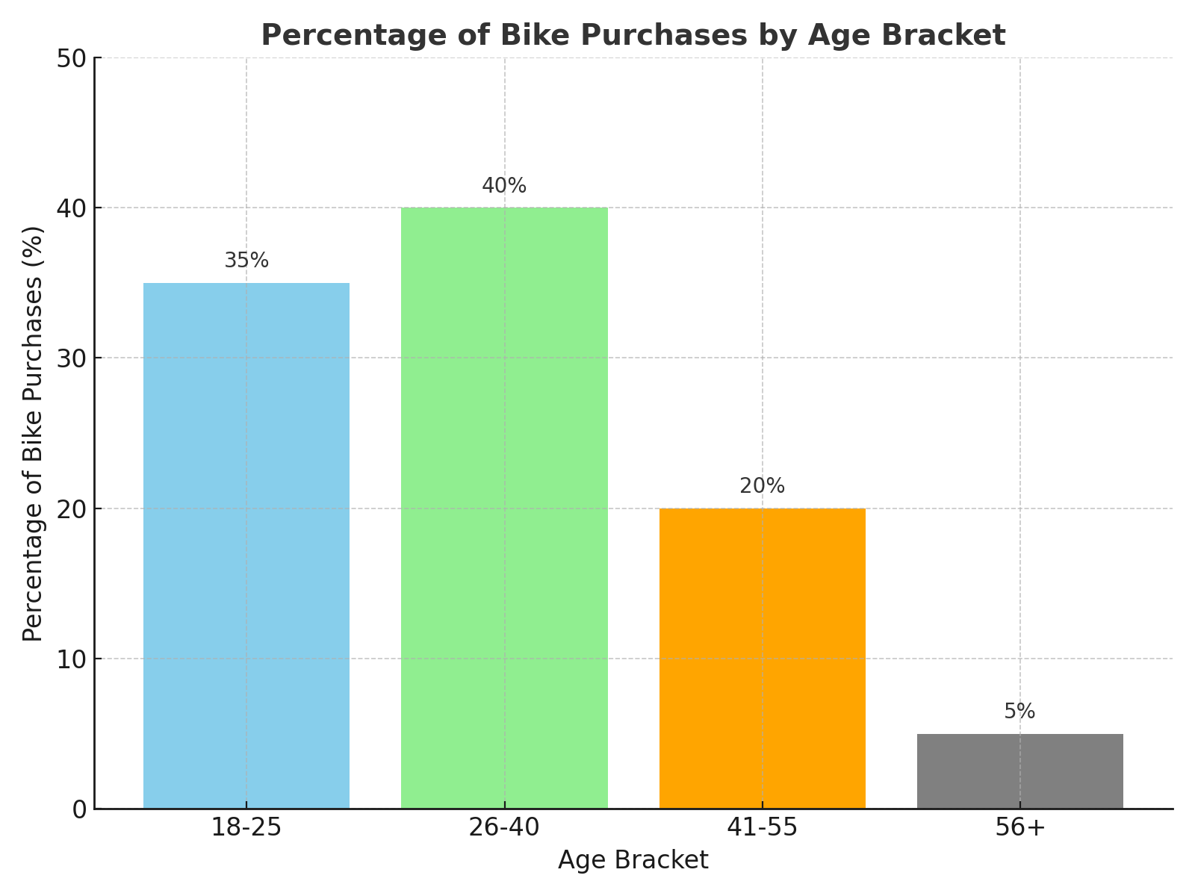
Results
The Percentage of Bike Purchases in Each Age Bracket
The percentage of bike purchases across different age brackets offers valuable insights into consumer behavior and lifestyle preferences. Young adults aged 18–25 often make up a significant portion of bike buyers, driven by their preference for affordable and eco-friendly transportation, as well as a growing interest in fitness and outdoor activities. This age group may lean toward modern, lightweight bikes, such as road or hybrid bikes, to suit urban commuting or recreational use. The 26–40 age bracket typically exhibits a substantial percentage of bike purchases as well, often for family-oriented purposes or health-conscious lifestyles.

Slide 13
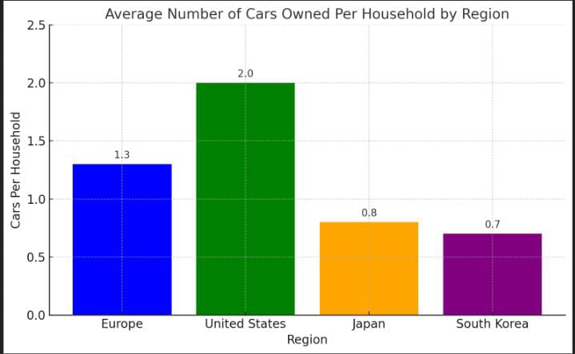
Results
Region With Most Cars Owned Per Households
Car ownership per household varies significantly between Europe and specific regions of the world due to differences in urbanization, public transportation infrastructure, income levels, and cultural preferences. Europe, particularly countries like Germany, Italy, and France, boasts high car ownership rates due to well-developed road networks and an automobile-driven economy. However, urban areas in Europe often show lower car ownership per household because of efficient public transportation systems like trains and subways, which reduce dependency on private vehicles. In contrast, regions such as the United States within the specific Western Hemisphere exhibit some of the highest car ownership rates globally, often surpassing Europe.

Slide 14
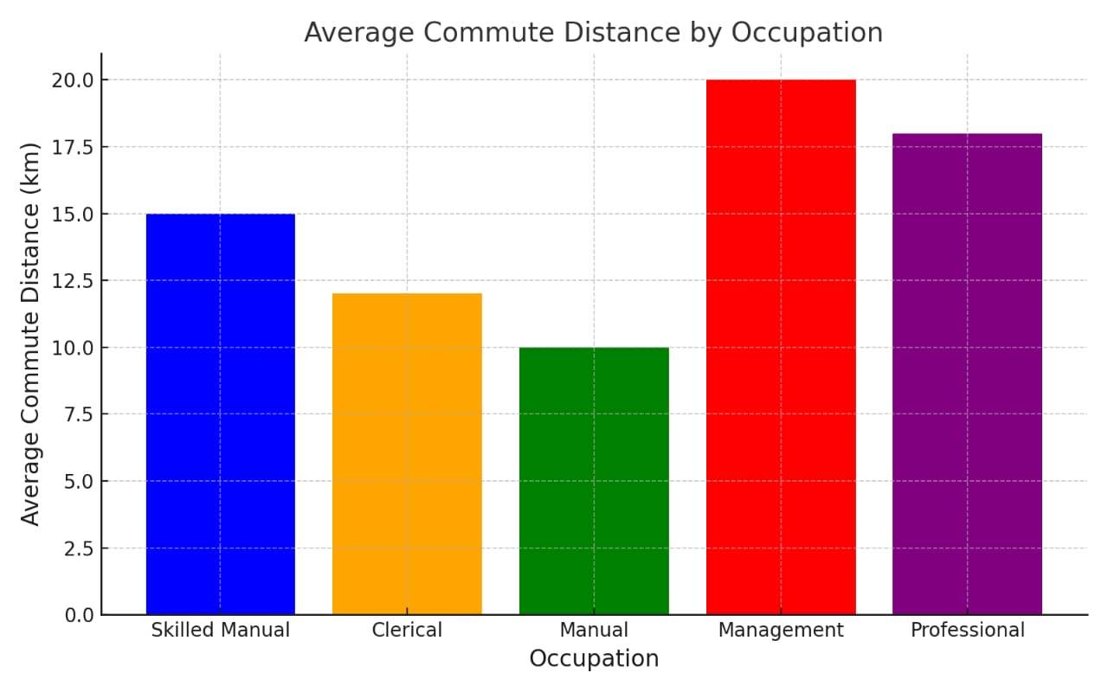
Results
Average Commute Distance by Occupation
Car ownership per household varies significantly between Europe and specific regions of the world due to differences in urbanization, public transportation infrastructure, income levels, and cultural preferences. Europe, particularly countries like Germany, Italy, and France, boasts high car ownership rates due to well-developed road networks and an automobile-driven economy. However, urban areas in Europe often show lower car ownership per household because of efficient public transportation systems like trains and subways, which reduce dependency on private vehicles. In contrast, regions such as the United States within the specific Western Hemisphere exhibit some of the highest car ownership rates globally, often surpassing Europe.

Slide 15
Conclusion
The analysis highlights significant trends and correlations within the dataset. Married individuals earn more on average than single individuals. Education plays a critical role in determining income.This report provides a comprehensive analysis of the individual data across various departments and roles. Key insights include the distribution of employees based on gender, education, experience, and job satisfaction, as well as the patterns in leave, overtime hours, and health insurance coverage. The findings will help the company make informed decisions .

